Slide 1
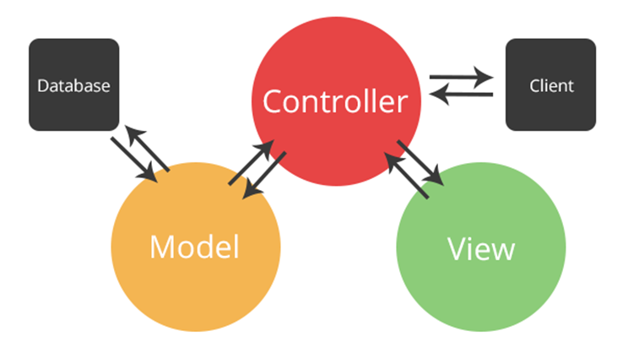

PHP: MVC and Symfony
MVC Architecture, Symfony Framework for PHP Web Apps
Software University
http://softuni.bg
SoftUni Team
Technical Trainers

Slide 2
Contents
MVC Concepts
Overview, Purpose
Symfony Framework
What is Symfony?
Install and Run Symfony
Annotations, Entities
Views & Controllers

Slide 3
Have a Question?
sli.do #TECH-SOFTUNI

Slide 4
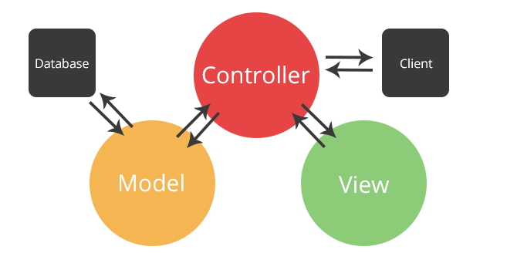
MVC
Overview, Purpose

Slide 5
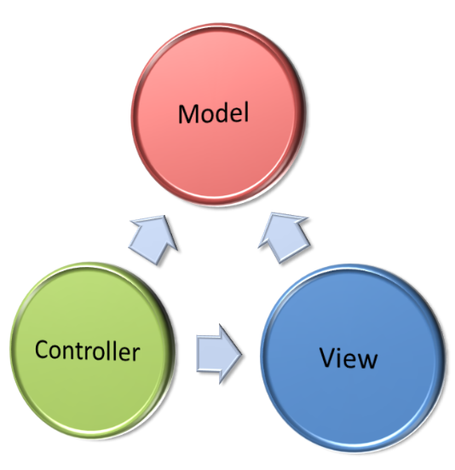
Model-View-Controller (MVC)
Model-View-Controller (MVC) is a software architecture pattern
Originally formulated in the late 1970s by Trygve Reenskaug
Code reusability and separation of concerns
Originally developed for desktop
Then adapted for internet applications

Slide 6

The MVC Pattern
Design pattern with three independent components
Model (data)
Manages data and database logic
View (UI)
Presentation layer (renders the UI)
Controller (logic)
Implements the application logic
Processes user request, performs an action, updates the data model and invokes a view to render some UI

Slide 7
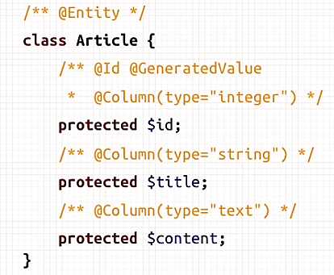
Model (Data)
Set of classes that describes the data we are working with
Rules for how the data can be changed and manipulated
May contain data validation rules
Often encapsulates data stored in a database
As well as code used to manipulate the data
E.g. Data Access Layer of some kind

Slide 8

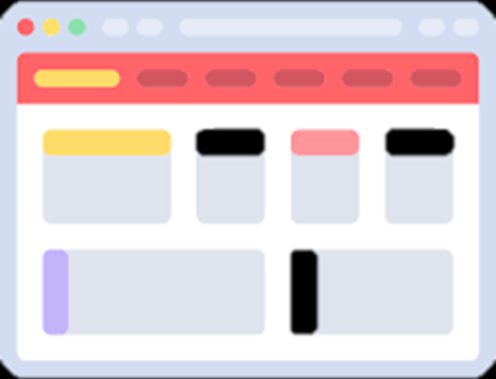

View (UI)
Defines how the application’s user interface (UI) will be displayed
May support master views (layouts)
May support sub-views (partial views or controls)
May use templates to dynamically generate HTML

Slide 9
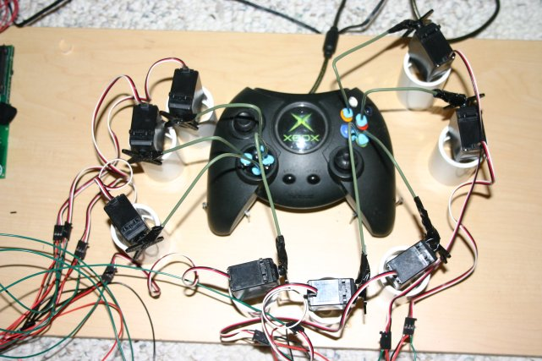
Controller (Logic)
The core MVC component – holds the logic
Process the requests with the help of views and models
A set of classes that handles
Communication from the user
Overall application flow
Application-specific logic (business logic)
Every controller has one or more "actions"

Slide 10

Symfony Framework
Web MVC Framework for PHP

Slide 11
What is Symfony?
Symfony == popular Web MVC framework for PHP
Created by Sensio Labs, open-source, large community
Works with many database types (MySQL, SQLite, MSSQL, etc..)
Entities managed by Doctrine
Defining data models and their properties
Scaffolding
Code generation tools (less manual typing)
Generates data models + DB tables (using Doctrine)

Slide 12
Installing and Running Symfony
Download symfony.phar from https://symfony.com/installer
Run the Symfony installer
Create a new Symfony project named "hello"
Run the Symfony Web server
Browse to the "hello" Web app at http://127.0.0.1:8000
php symfony.phar
php symfony.phar new hello
php .\hello\bin\console server:run

Slide 13
Symfony App Structure
Bundles
Bundles are application components (modules), e.g. AppBundle
Controllers
src/AppBundle/Controller/
Views
app/Resources/views/
Models
src/AppBundle/Entity/, src/AppBundle/Repository/

Slide 14
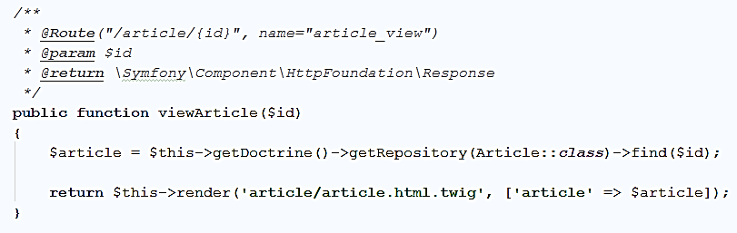
Annotations in Symfony
Annotations == comments used by Symfony to modify the method behavior
URL that calls the controller action
Action Parameters
Action name
Return type
Describes this action

Slide 15
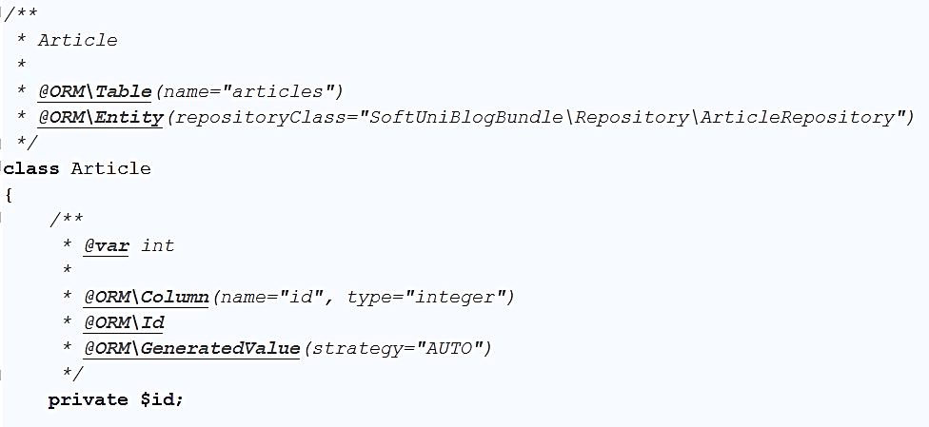
Doctrine Entities (Models in Symfony)
Models (data classes) describe the objects, stored in the DB
Database table name
Class name
Field data type
Column in the database table
Field name

Slide 16
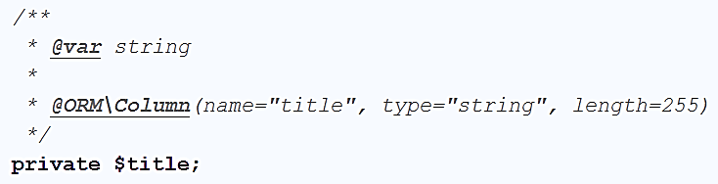
Symfony Entities: Fields
Entities have fields and properties like in C#
Use annotations for additional functionality
Tell the database what column names and types to use
Data type
Table column name
Table column type
Table column max length
Field name

Slide 17
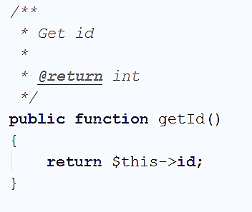
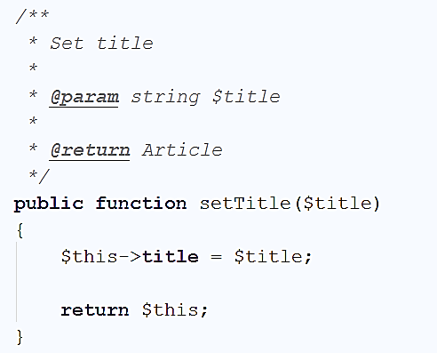
Symfony Entities: Properties
Getters and setters (like in C#)
Parameter type
Return type
Return type
Function name
Function name
Set title
Accessing the field
Return the object

Slide 18
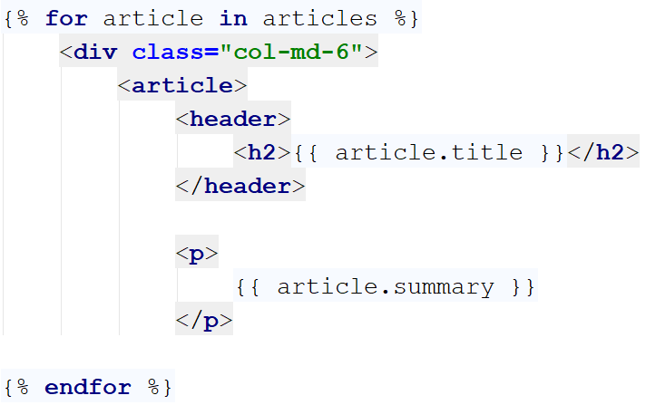
Symfony Views (Twig Templates)
Using the Twig view engine to simplify generating HTML:
Twig foreach loop
Twig syntax to print data
HTML code
Twig syntax

Slide 19
Symfony Controllers and Actions
Action == functions called by accessing a specific URL route
Controller action route
Action name
Action Parameters
Return type
Controller action

Slide 20
Composer: Dependency Manager for PHP
Composer – https://getcomposer.org
Package (dependency) management tool for PHP
Like the npm in the Node.js world
Installing and running Composer:
Run the installer from https://getcomposer.org/Composer-Setup.exe
Run composer:
Packagist – https://packagist.org
Composer's official open-source package repository
composer

Slide 21
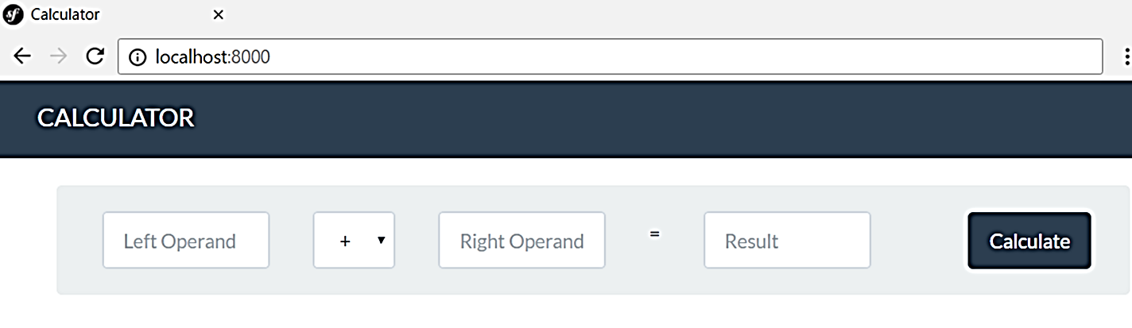
Problem: Simple Calculator Web Application
Write a Symfony-based PHP Web application to calculate the result of two operands
Implement addition, subtraction, multiplication and division

Slide 22

Live Exercises

Slide 23

Summary
…
…
…
MVC
Popular design pattern (architectural model)
Runs most of the Web apps
Code is organized into Models, Views and Controllers
Symfony
Web MVC framework for PHP
Establishes communication between the user, web application and the database

Slide 24
Course URL

Slide 25






SoftUni Diamond Partners

Slide 26






SoftUni Diamond Partners

Slide 27

License
Настоящият курс (слайдове, примери, видео, задачи и др.) се разпространяват под свободен лиценз "Creative Commons Attribution-NonCommercial-ShareAlike 4.0 International"
Благодарности: настоящият материал може да съдържа части от следните източници
Книга "Основи на програмирането със Java" от Светлин Наков и колектив с лиценз CC-BY-SA

Slide 28





Trainings @ Software University (SoftUni)
Software University – High-Quality Education, Profession and Job for Software Developers
softuni.bg
Software University Foundation
http://softuni.foundation/
Software University @ Facebook
facebook.com/SoftwareUniversity
Software University Forums
forum.softuni.bg

